Slide 1

Fruit image Classification and identification of its ripeness Using Deep Learning
Capstone Project Phase B Project 23-1-R-7
Students:
Shani Froik
Lior Saghi
Supervisor:
Ilya Zeldner

Slide 2
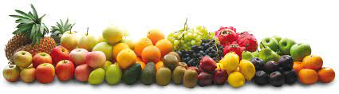
Introduction
Helps people's health
Helps people with disabilities
Manual sorting is not good enough

Slide 3
Our method
Step 1- Classification fruit type
Step 2- Classification of fruit maturity level by days
Using deep learning architecture

Slide 4
Challenges
There is not much information about evaluating the ripeness of a fruit.
There is no suitable data set.
There are many different varieties and types of the same fruit.

Slide 5
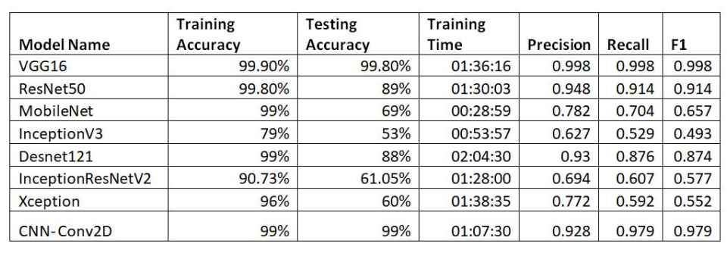
Classification

Slide 6
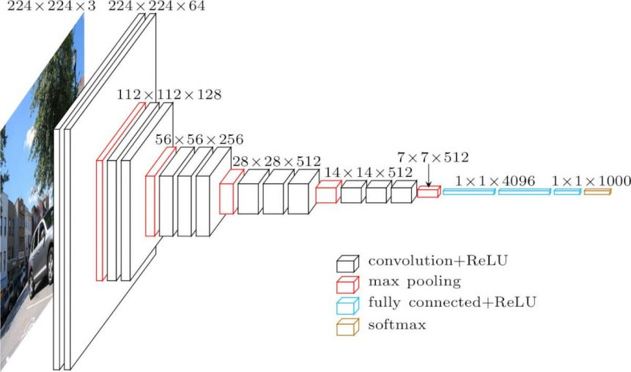
Step 1 - Classification fruit type
Visual Geometry Group (VGG)16 architecture

Slide 7
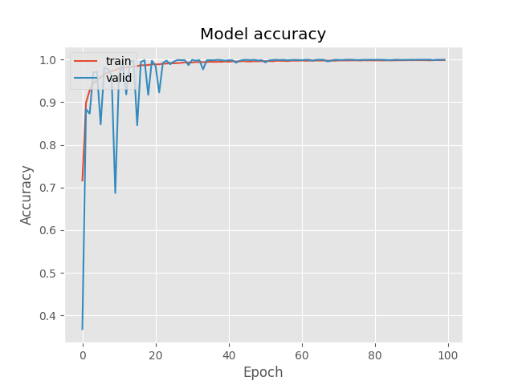
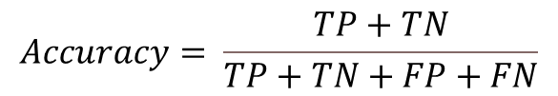
Training Fruit Type Results
Accuracy
Our model reached training accuracy of 99.51% and 98.91% for validation.
$$Accuracy= \frac{TP+TN}{TP+TN+FP+FN}$$
TP = True Positives, TN = True Negatives, FP = False Positives, and FN = False Negatives.

Slide 8
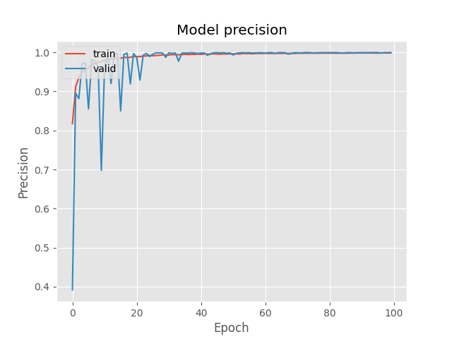
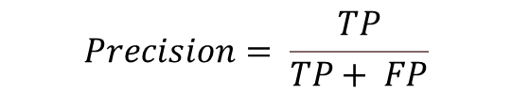
Training Fruit Type Results
Precision
Our model reached training Precision of 99.52% and 98.91% for validation.
$$Precision= \frac{TP}{TP+ FP}$$
TP = True Positives, TN = True Negatives, FP = False Positives, and FN = False Negatives.

Slide 9
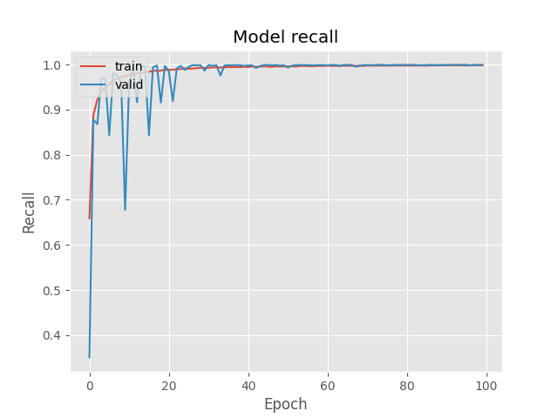
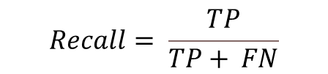
Training Fruit Type Results
Recall
Our model reached a training recall of 99.51% and 98.87% for validation.
$$Recall= \frac{TP}{TP+ FN}$$
TP = True Positives, TN = True Negatives, FP = False Positives, and FN = False Negatives.

Slide 10
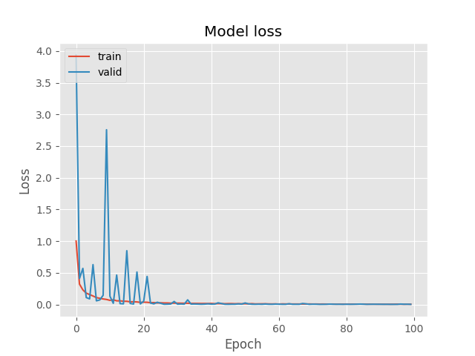
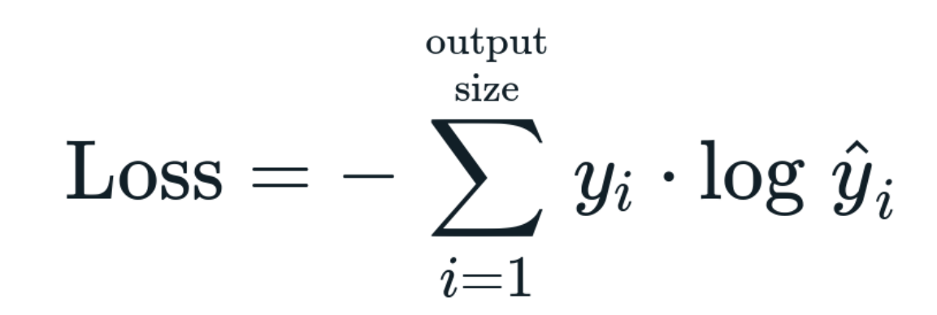
Training Fruit Type Results
Loss
Our model reached a training loss of 0.0174 and 0.0344 for validation.

Slide 11
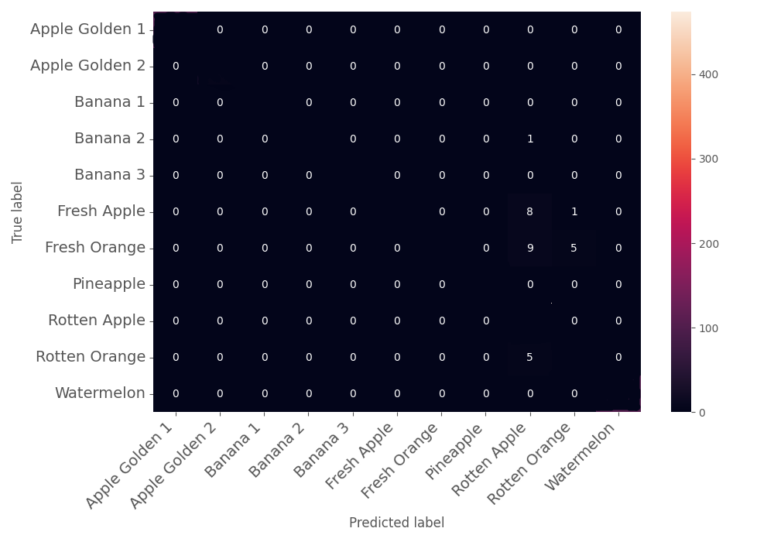
Training Results
Confusion Matrix
101
78
91
329
438
319
290
100
474
312
105

Slide 12
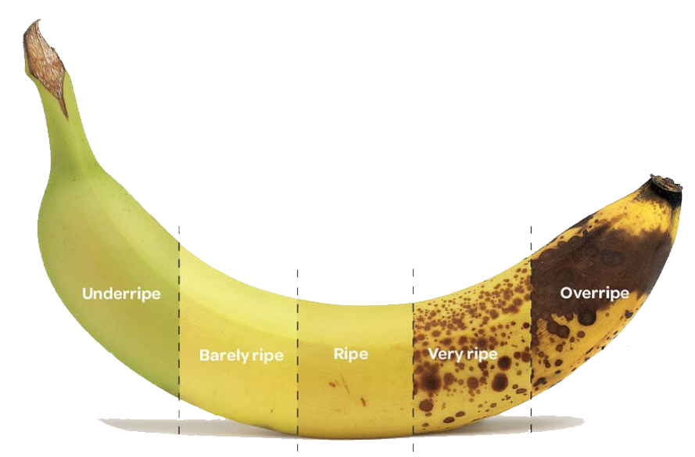
Second step – classification of the ripeness of the fruit

Slide 13
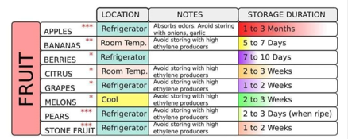
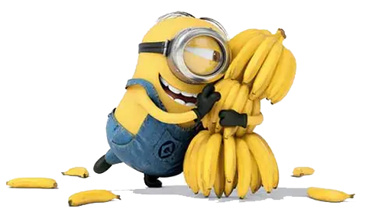
Second step – build the dataset

Slide 14
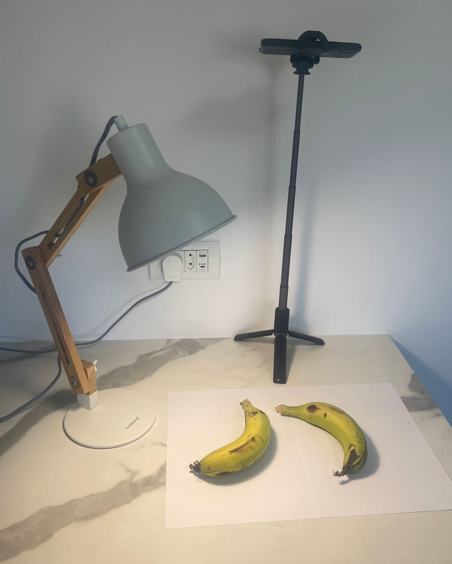
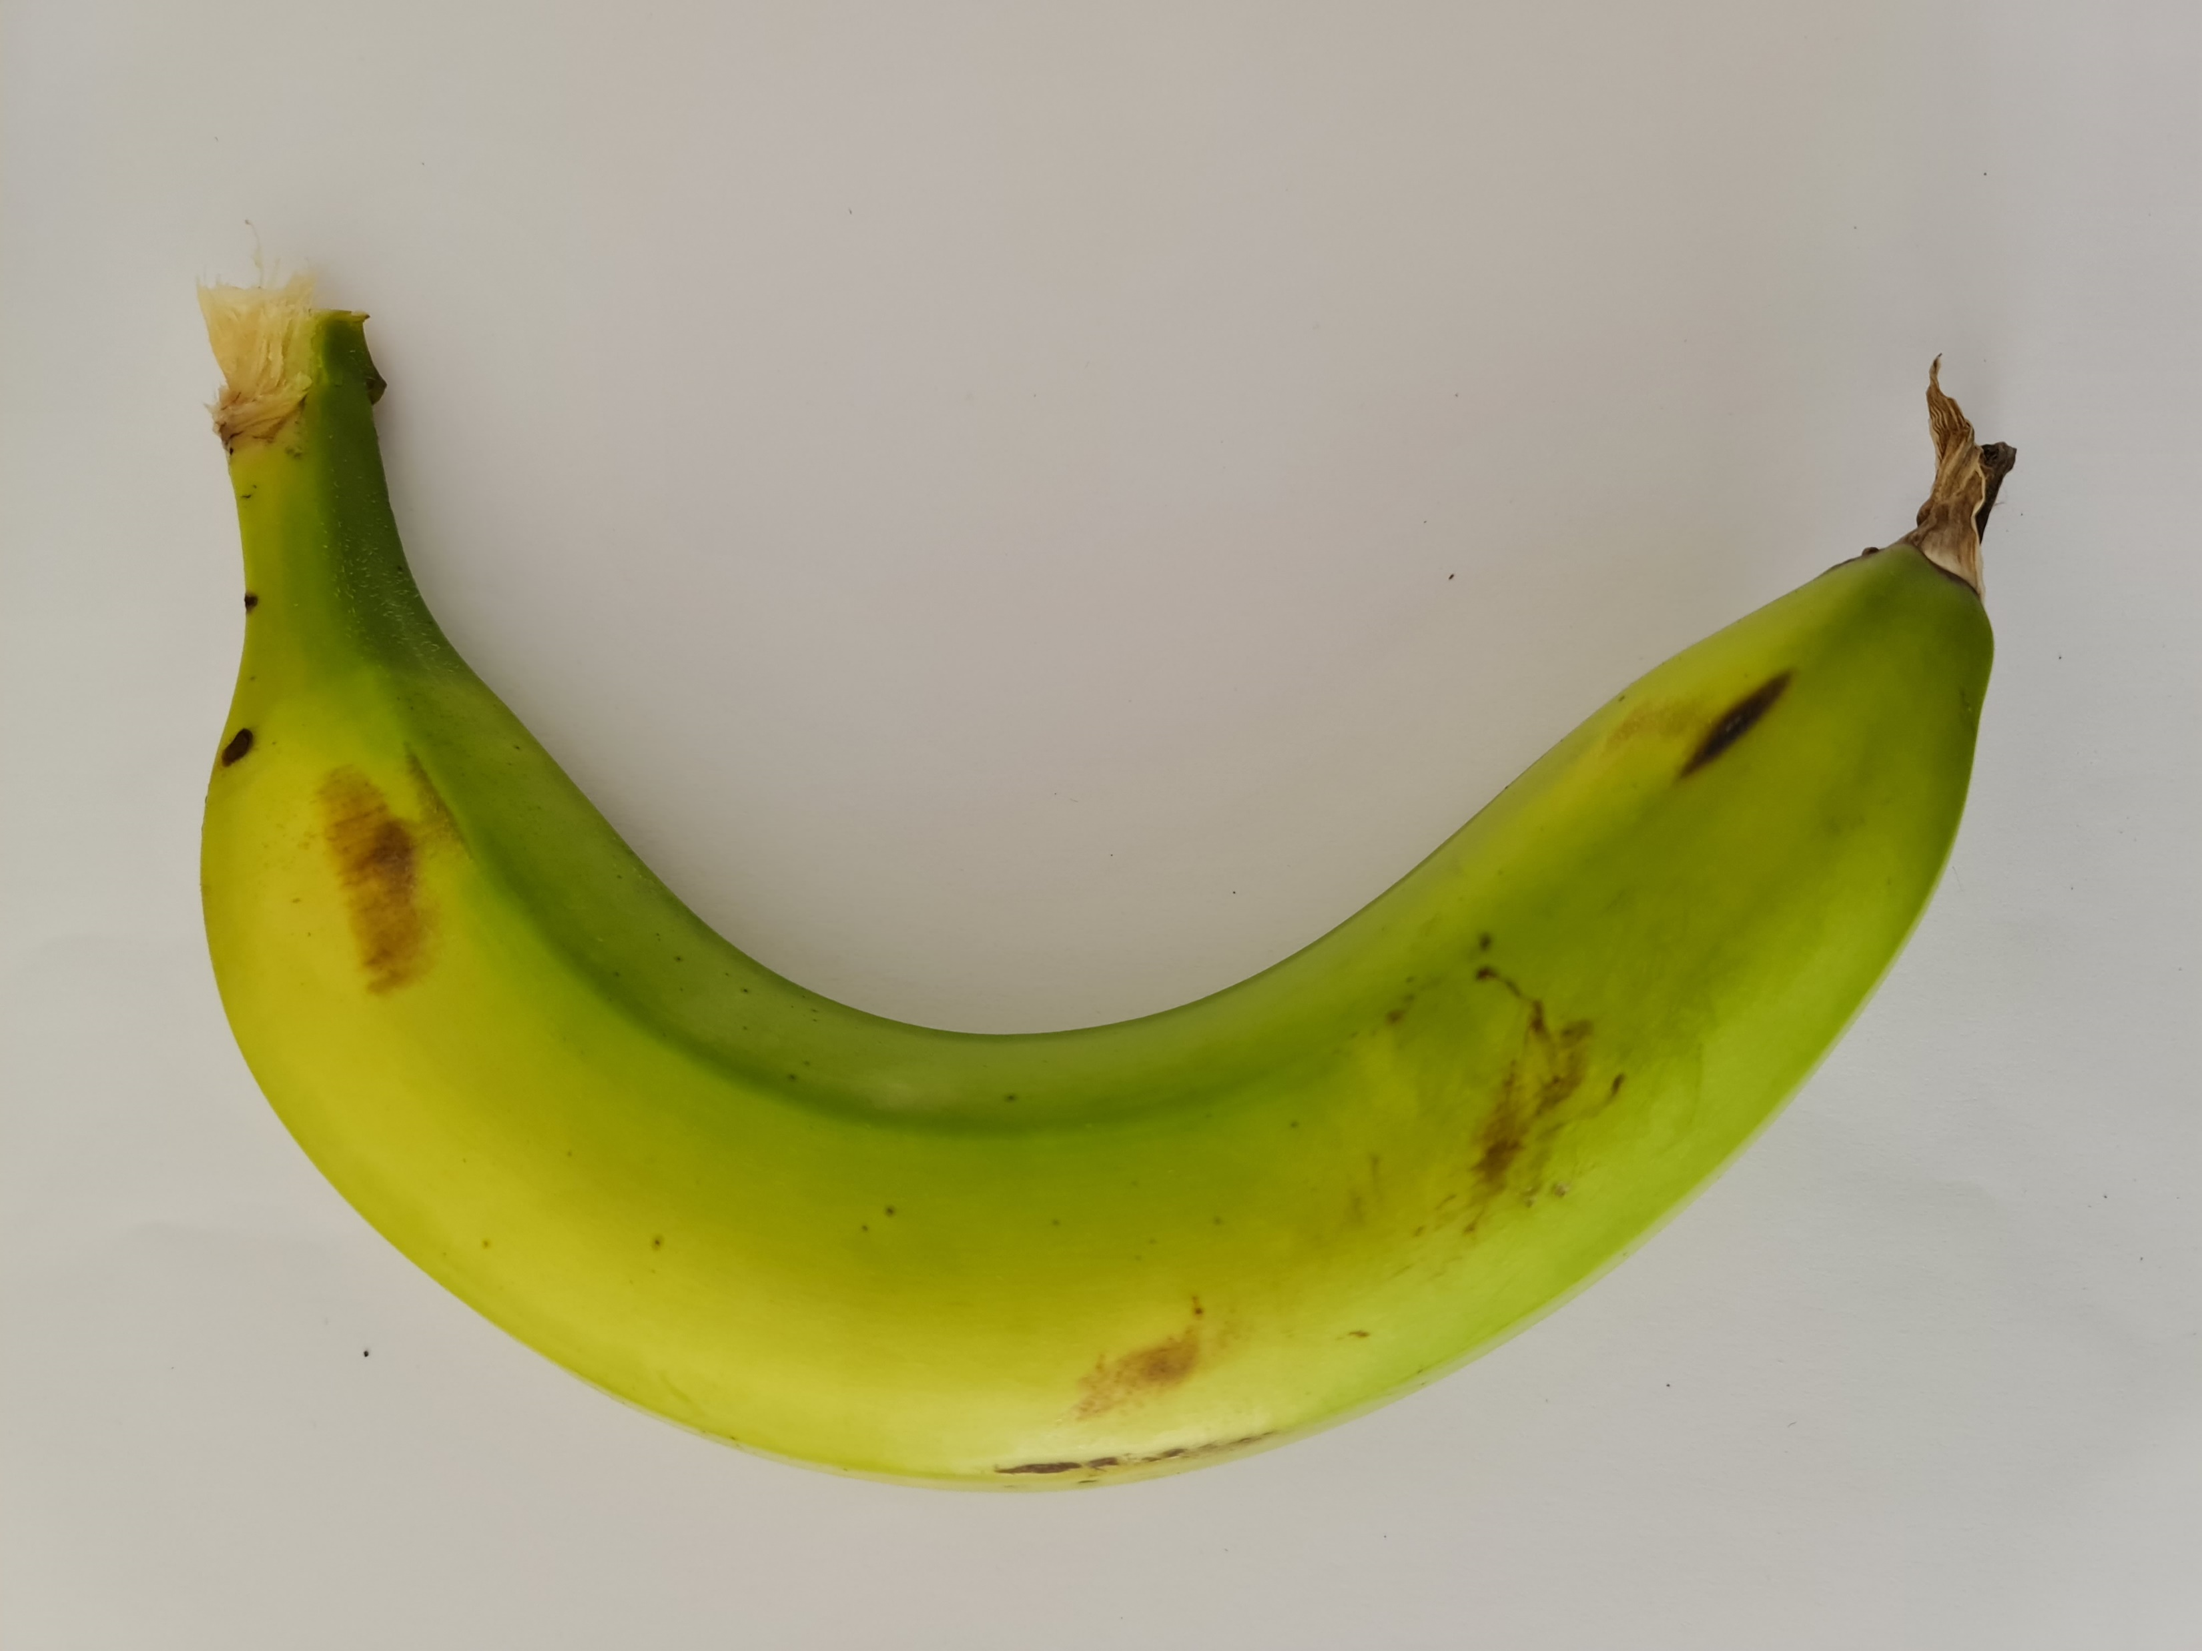
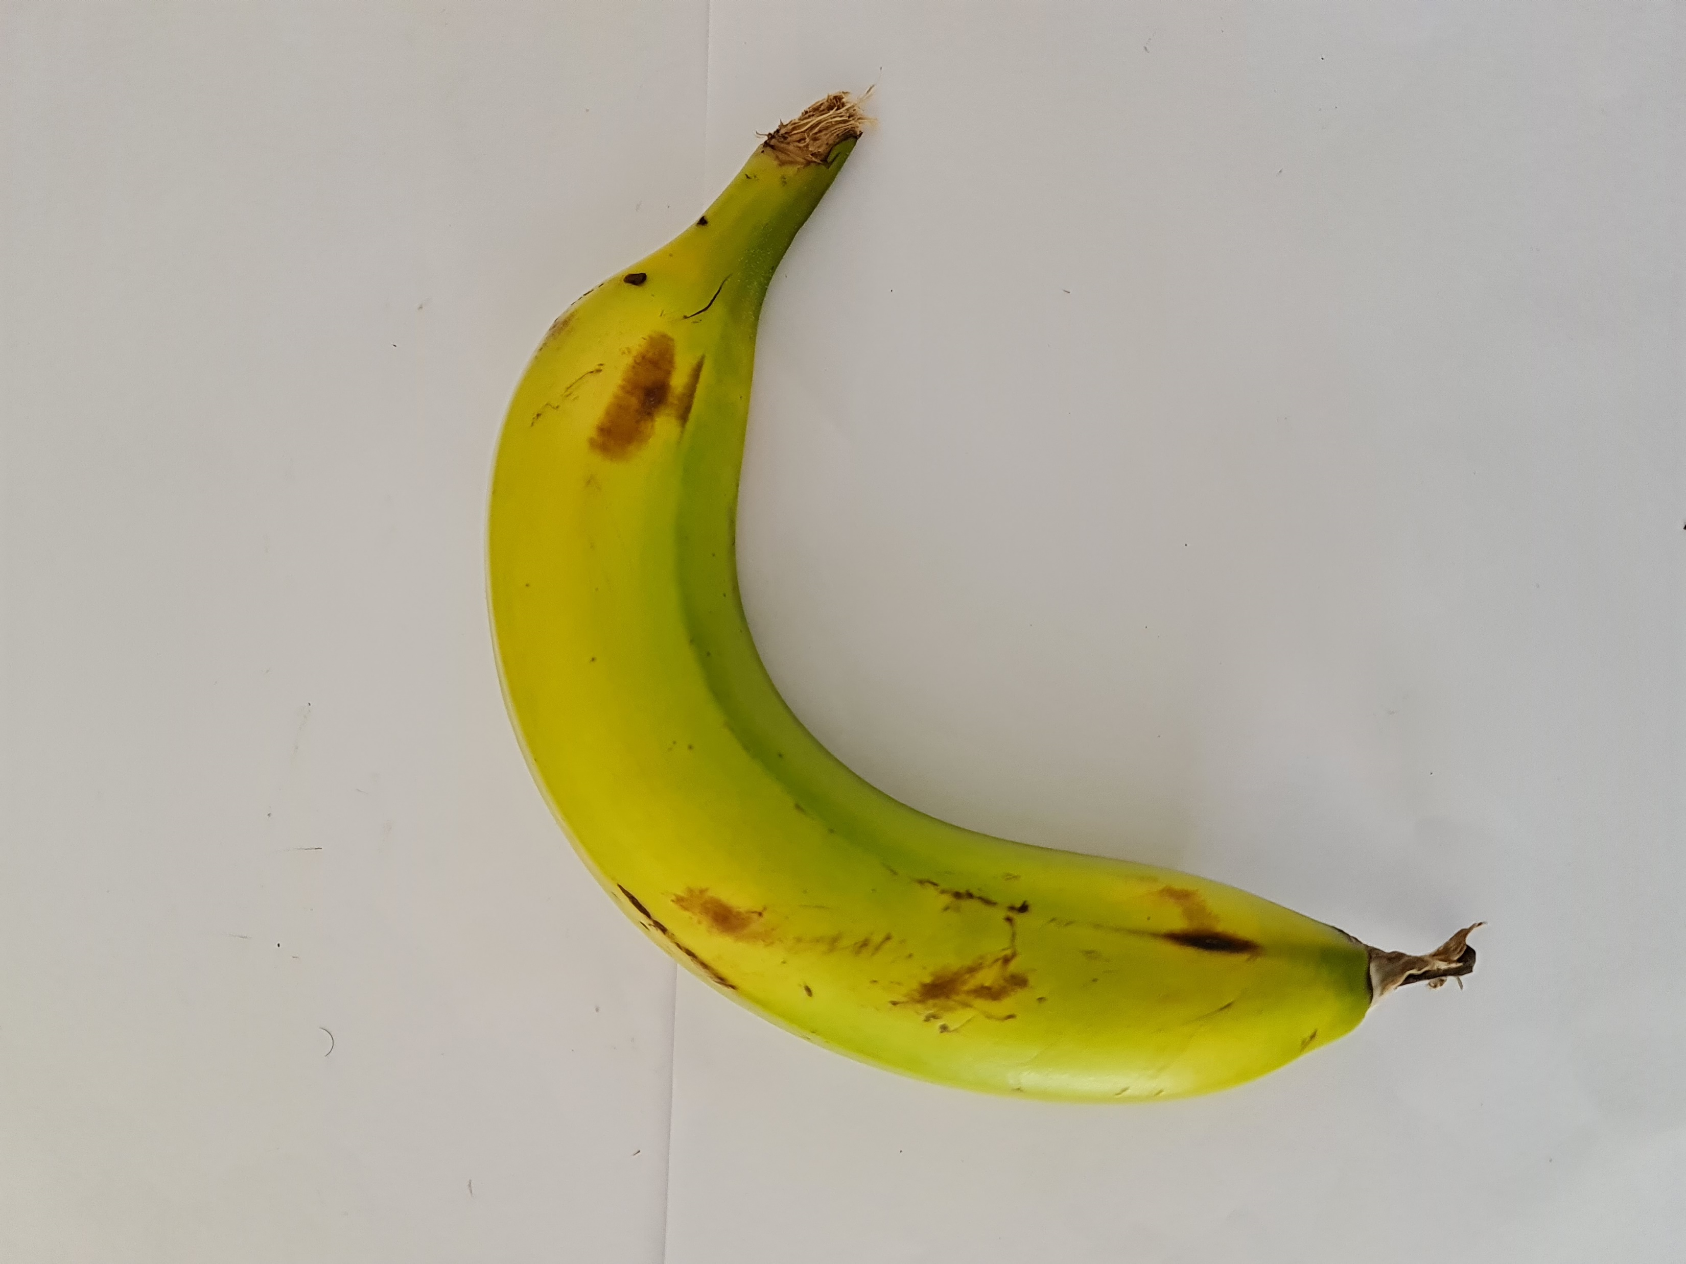
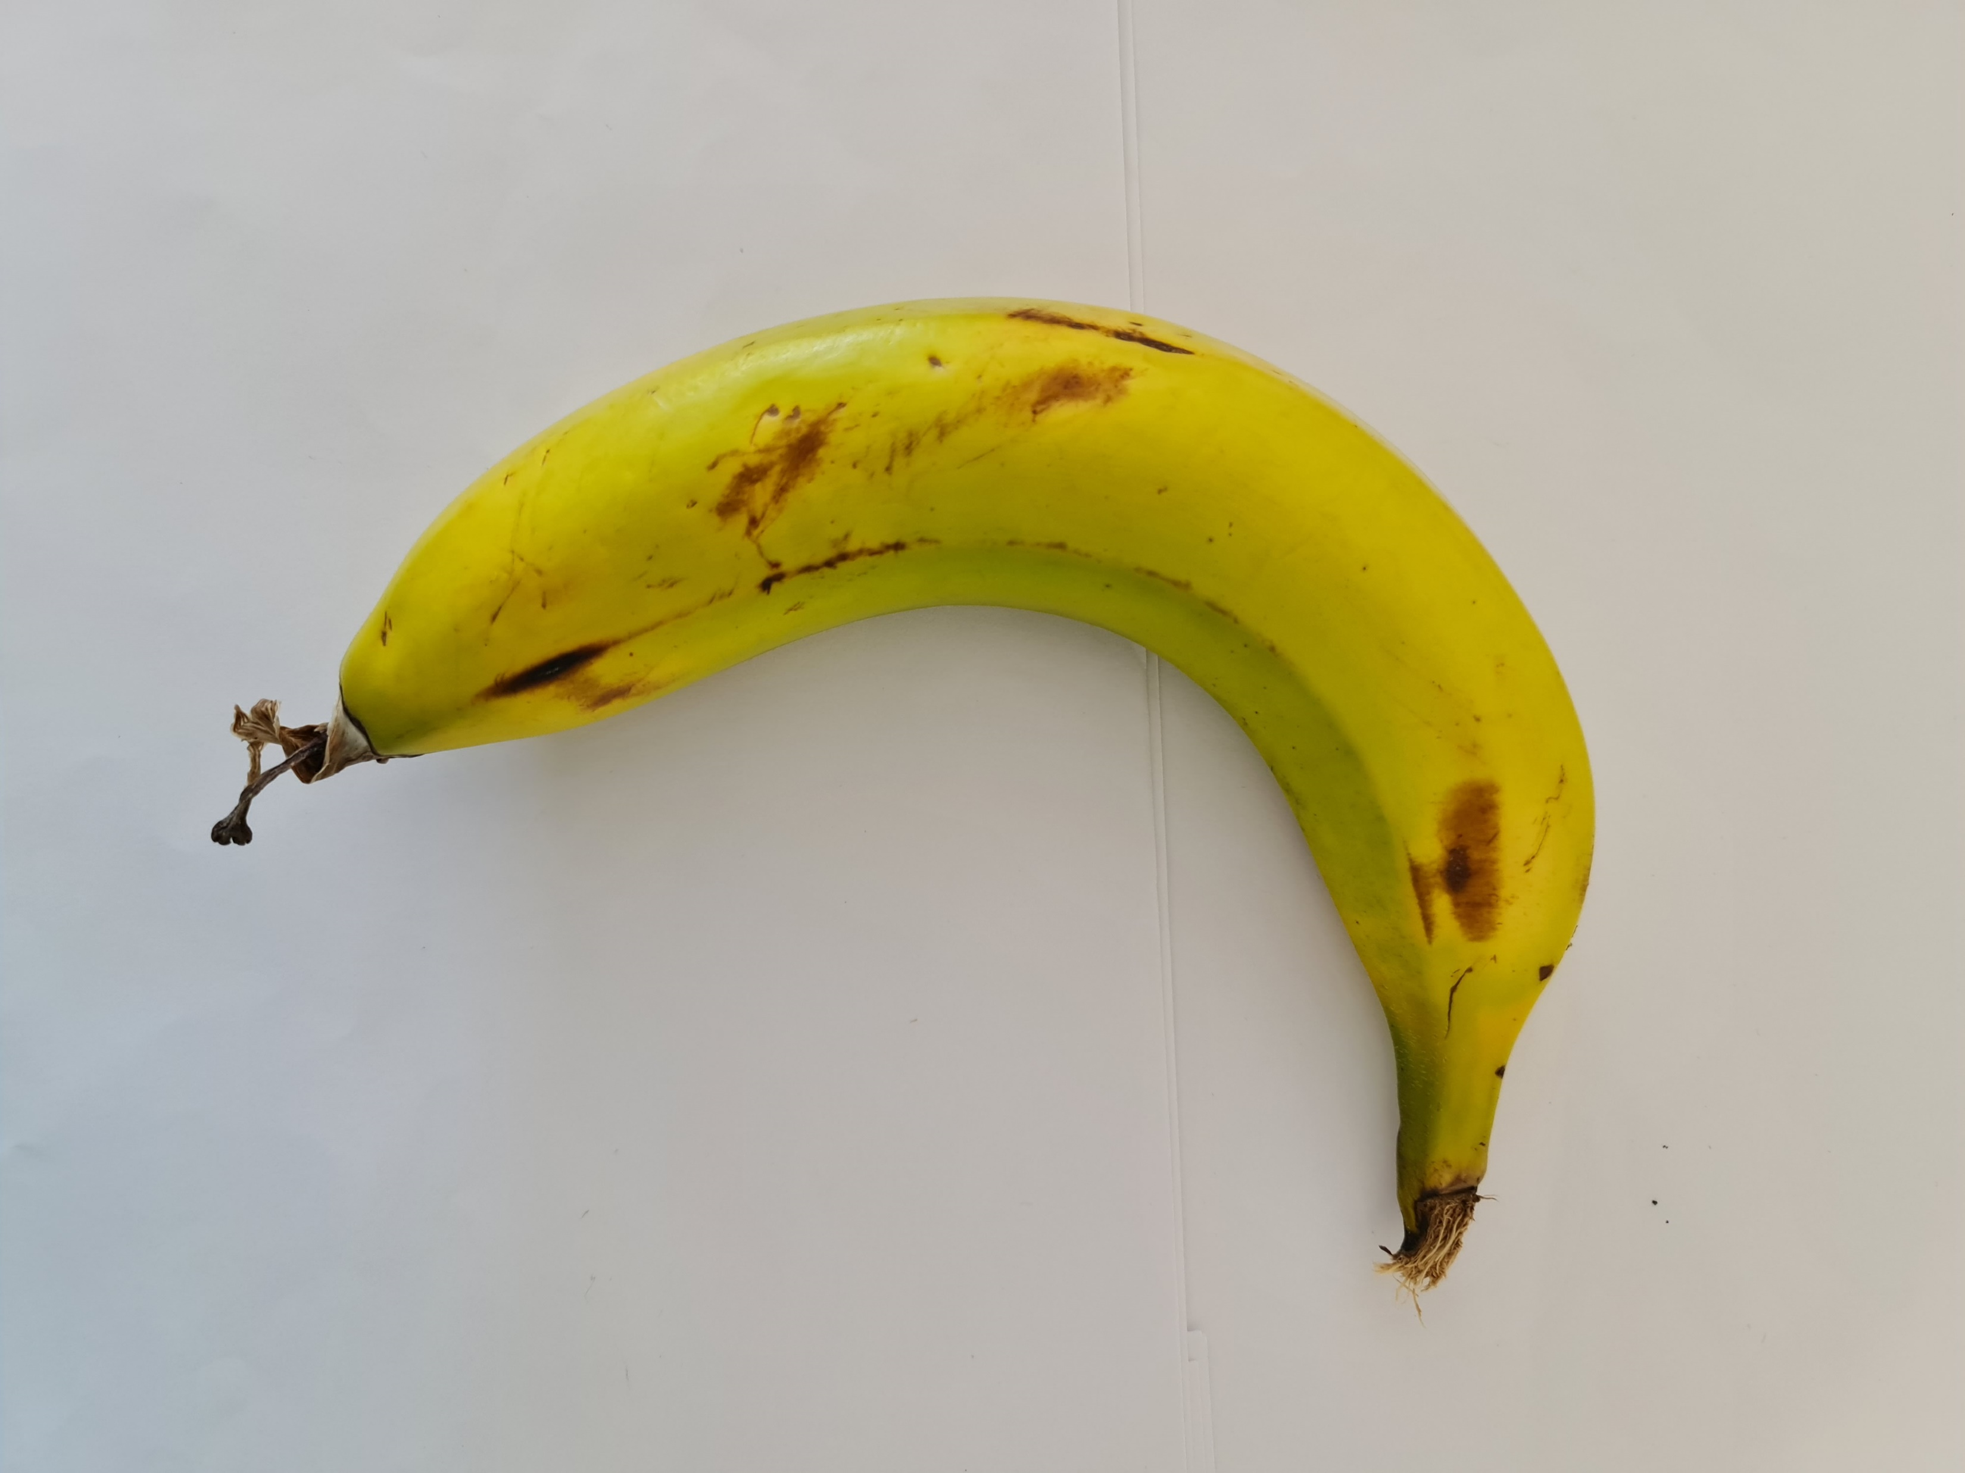
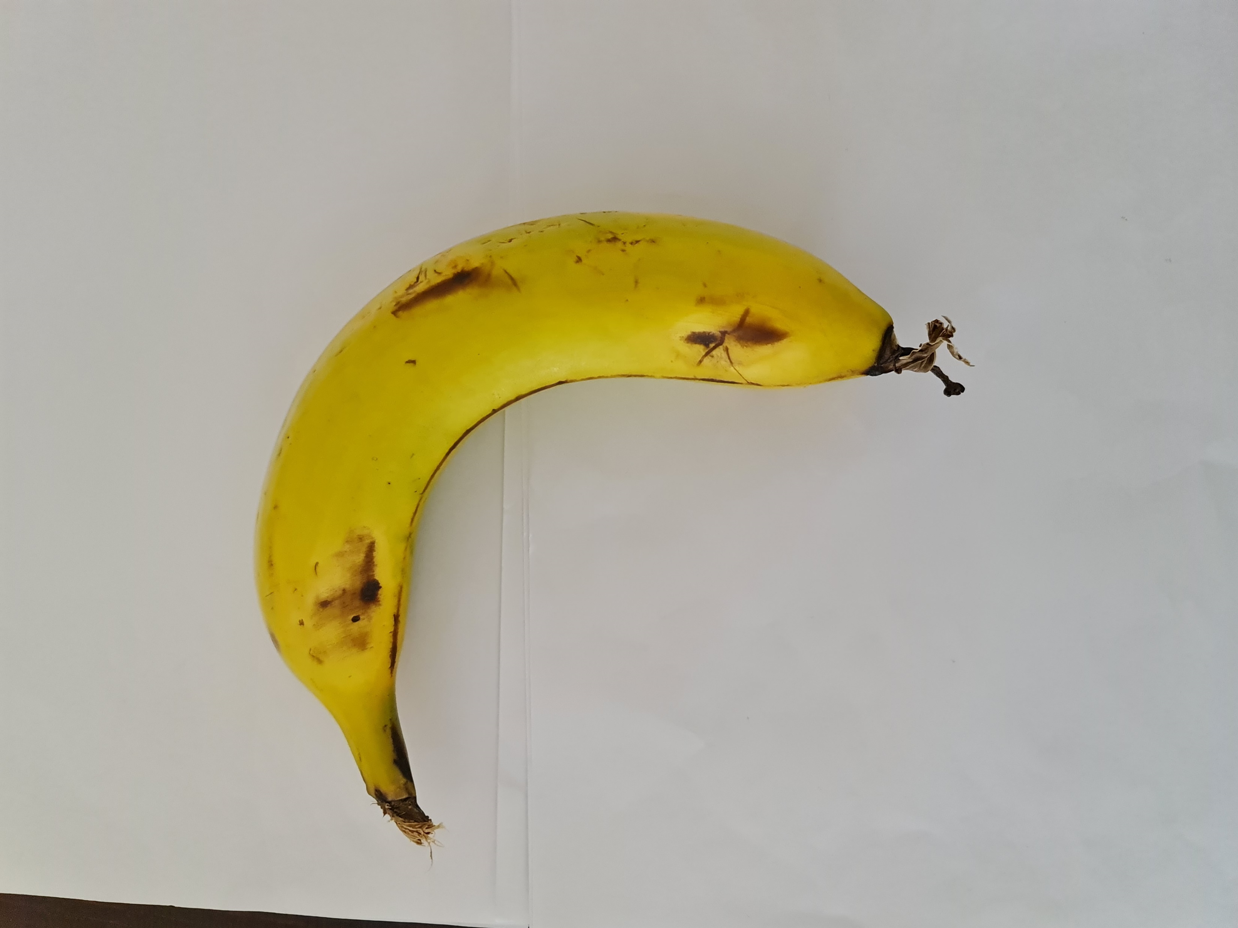
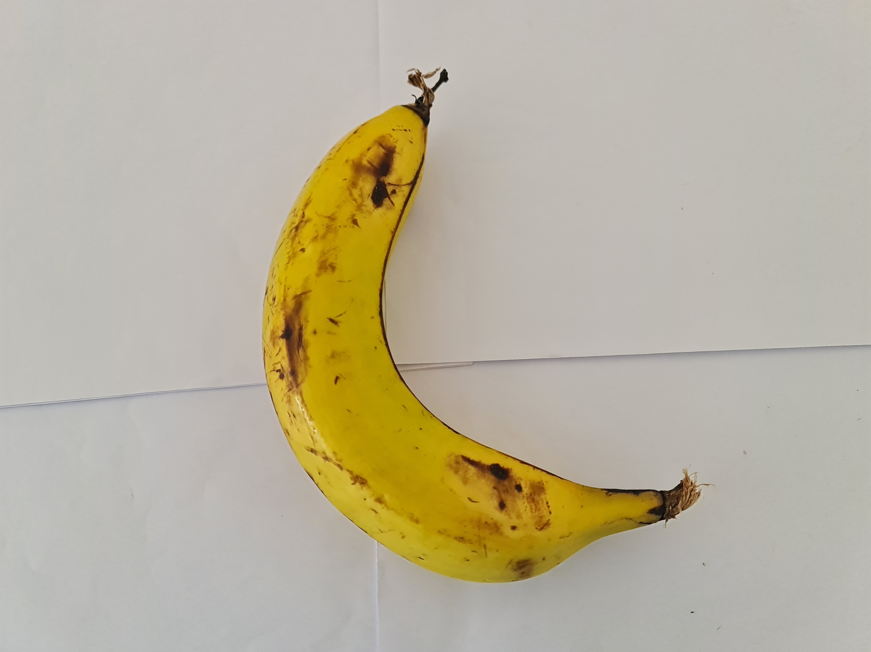
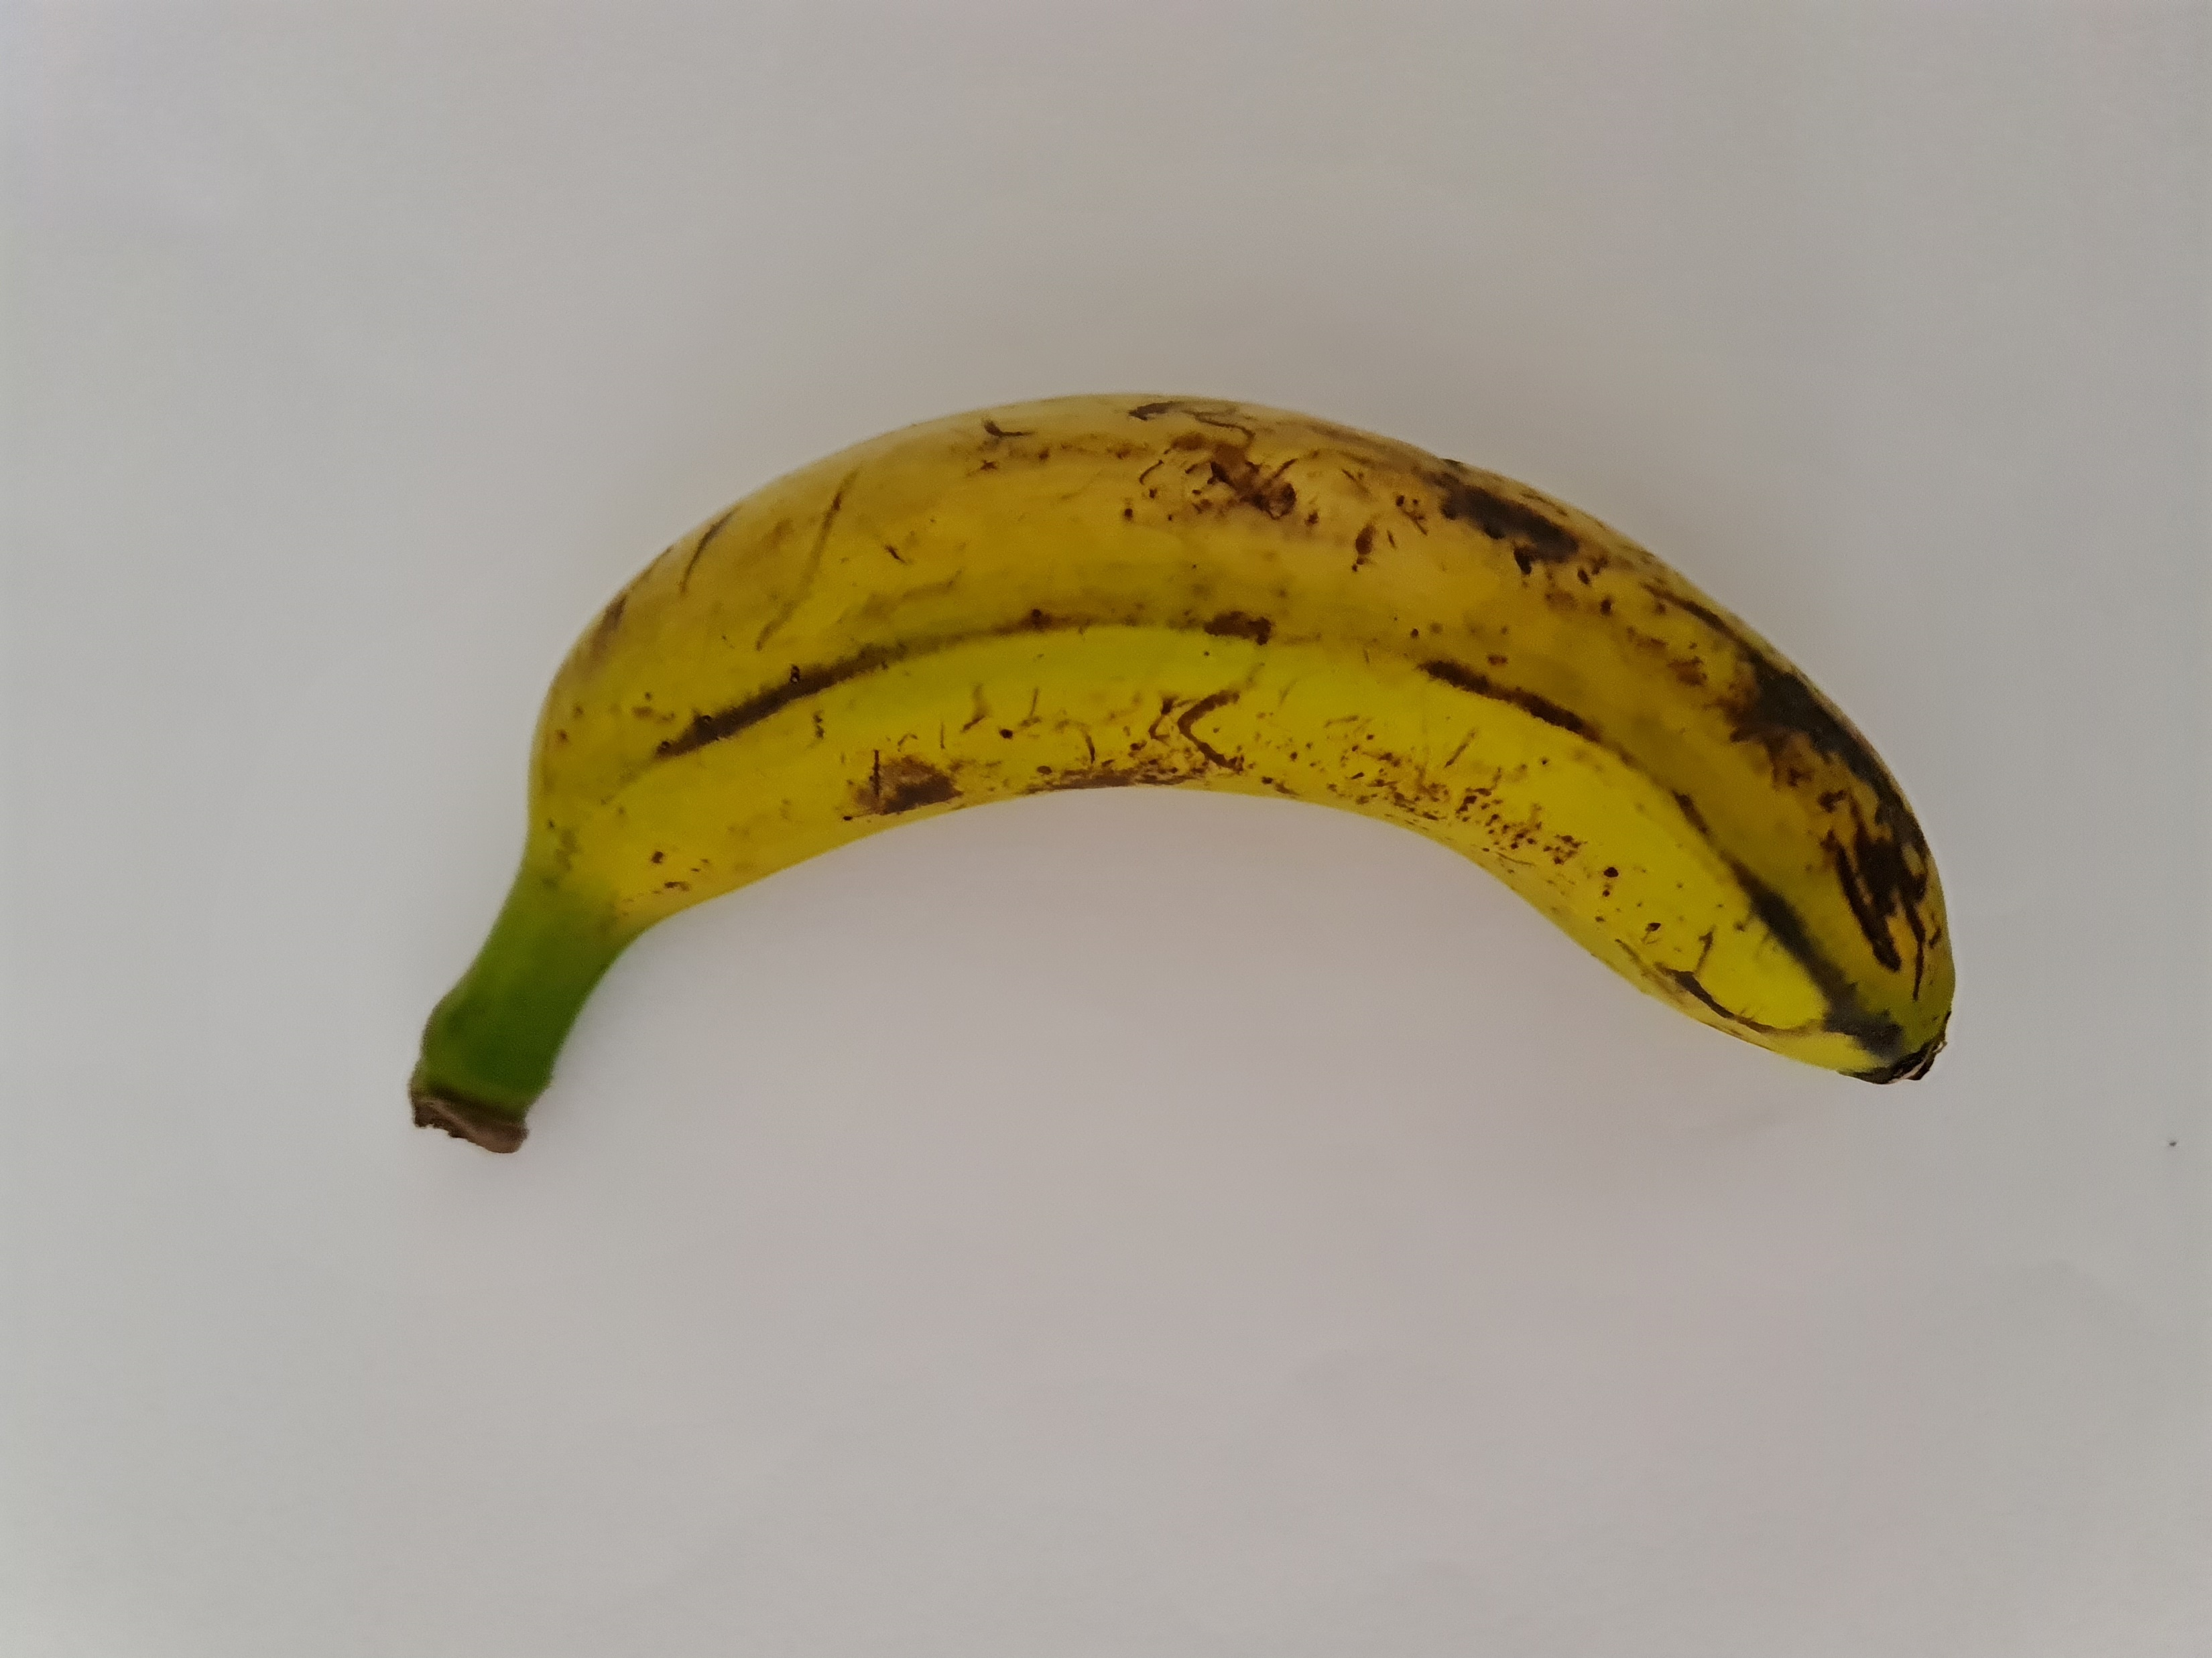
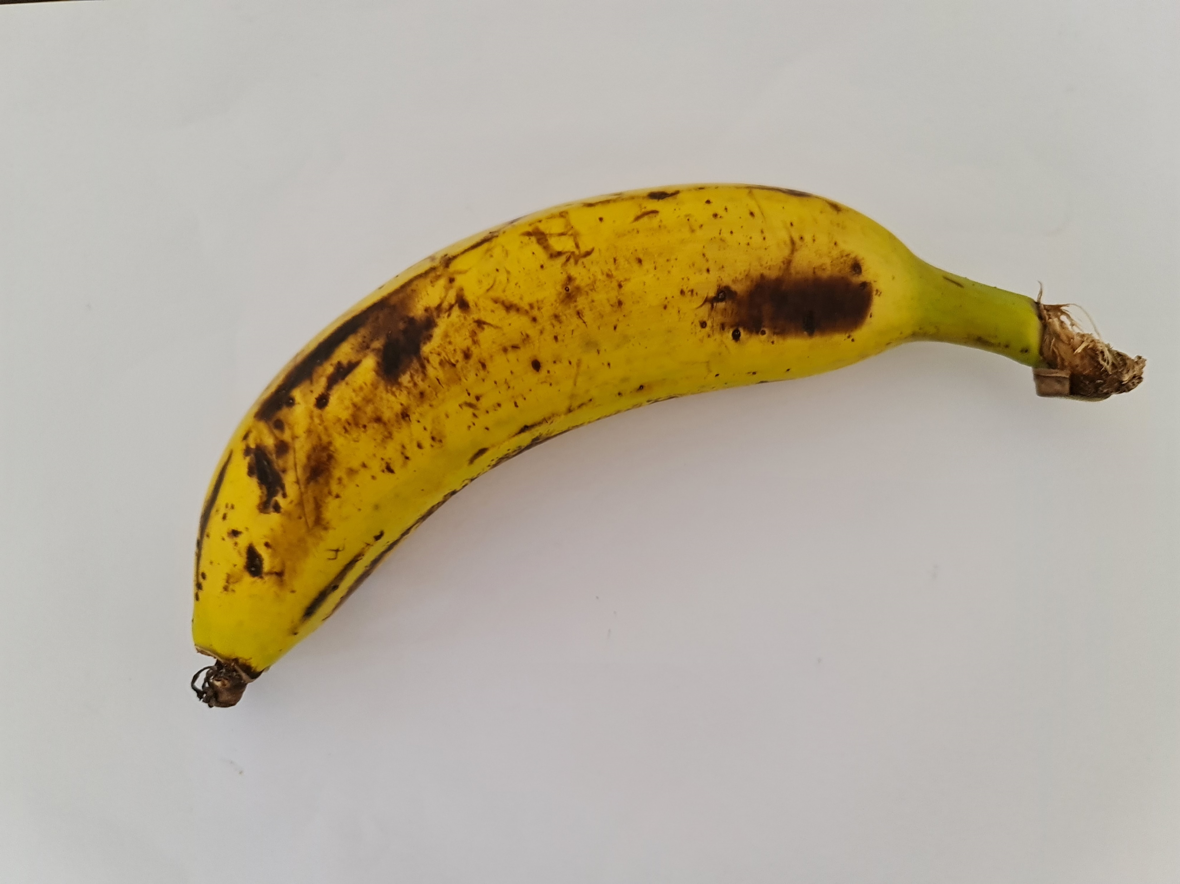
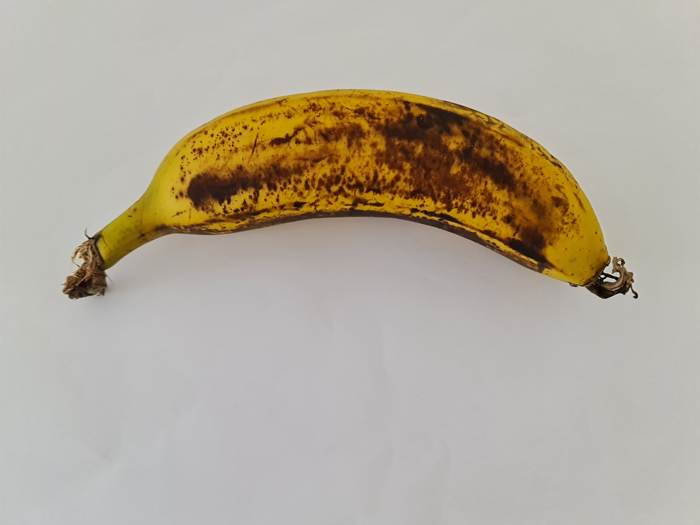
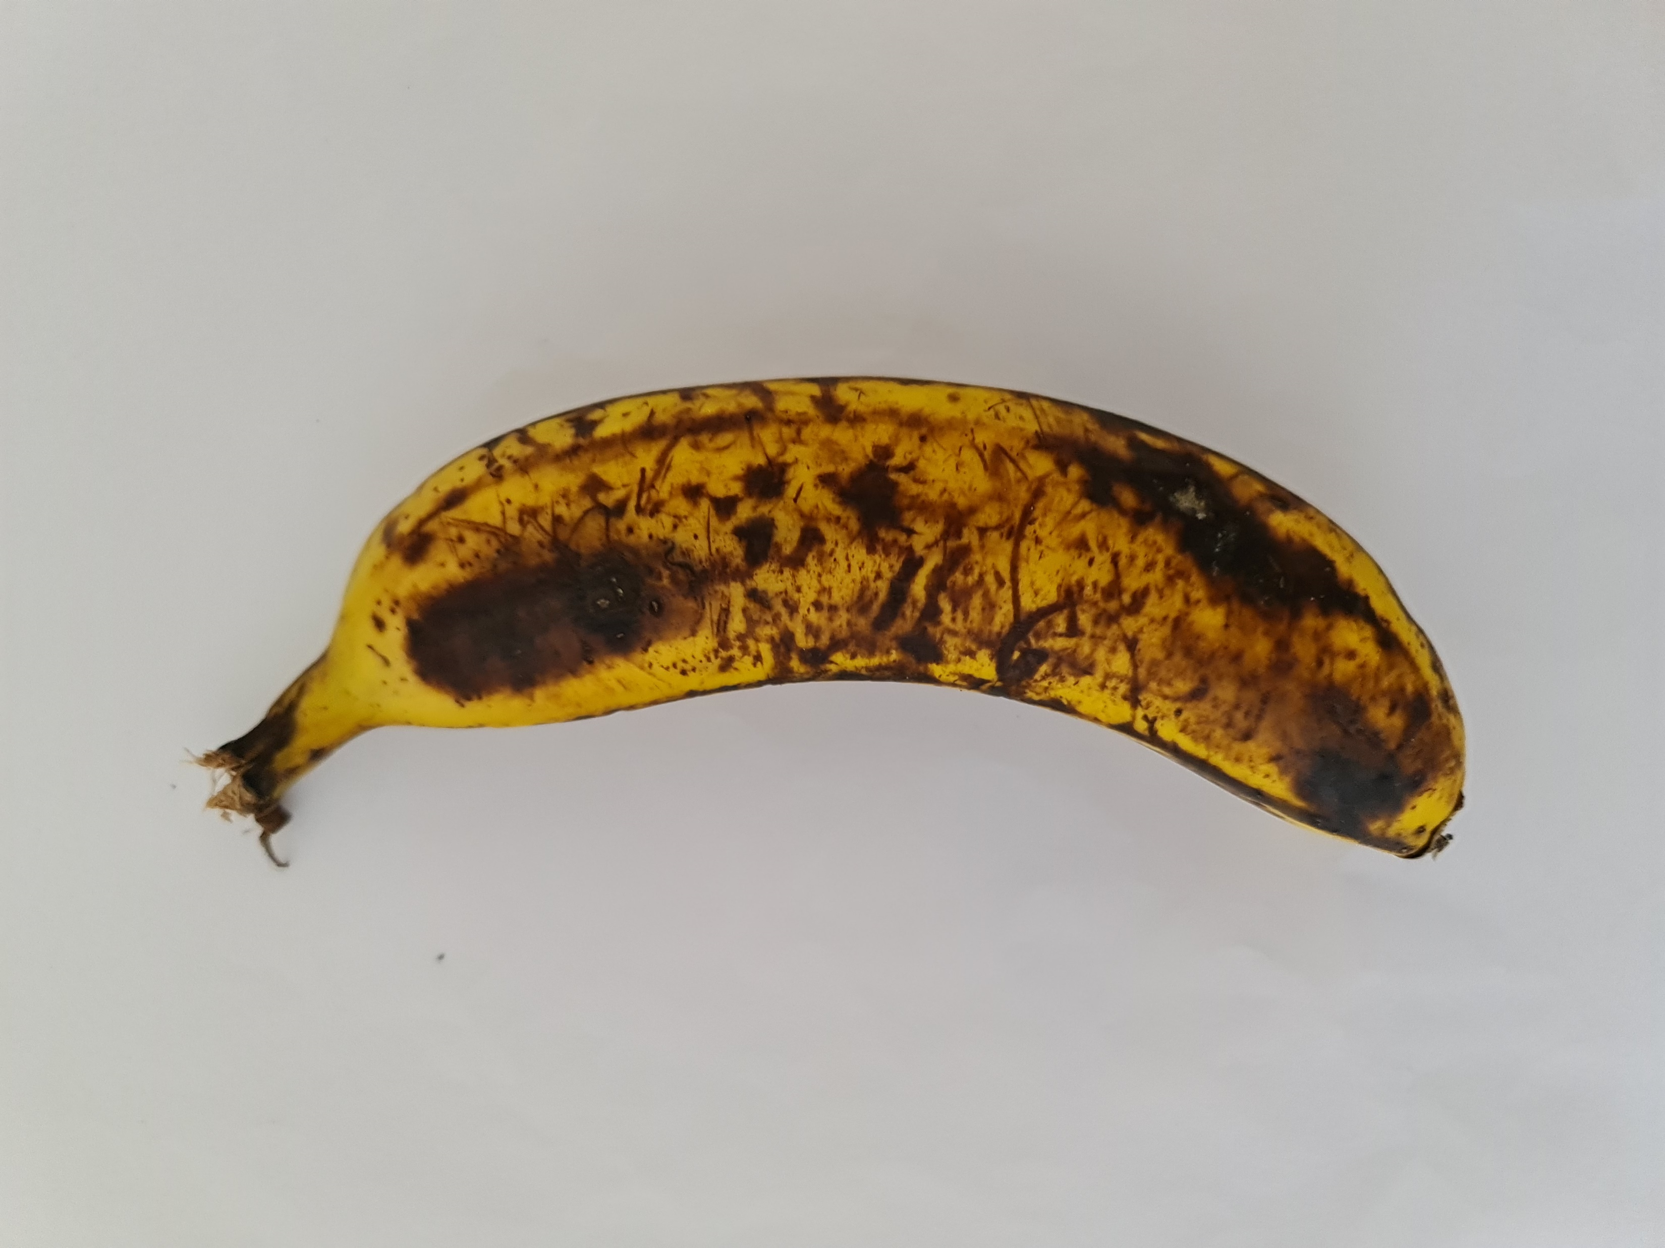
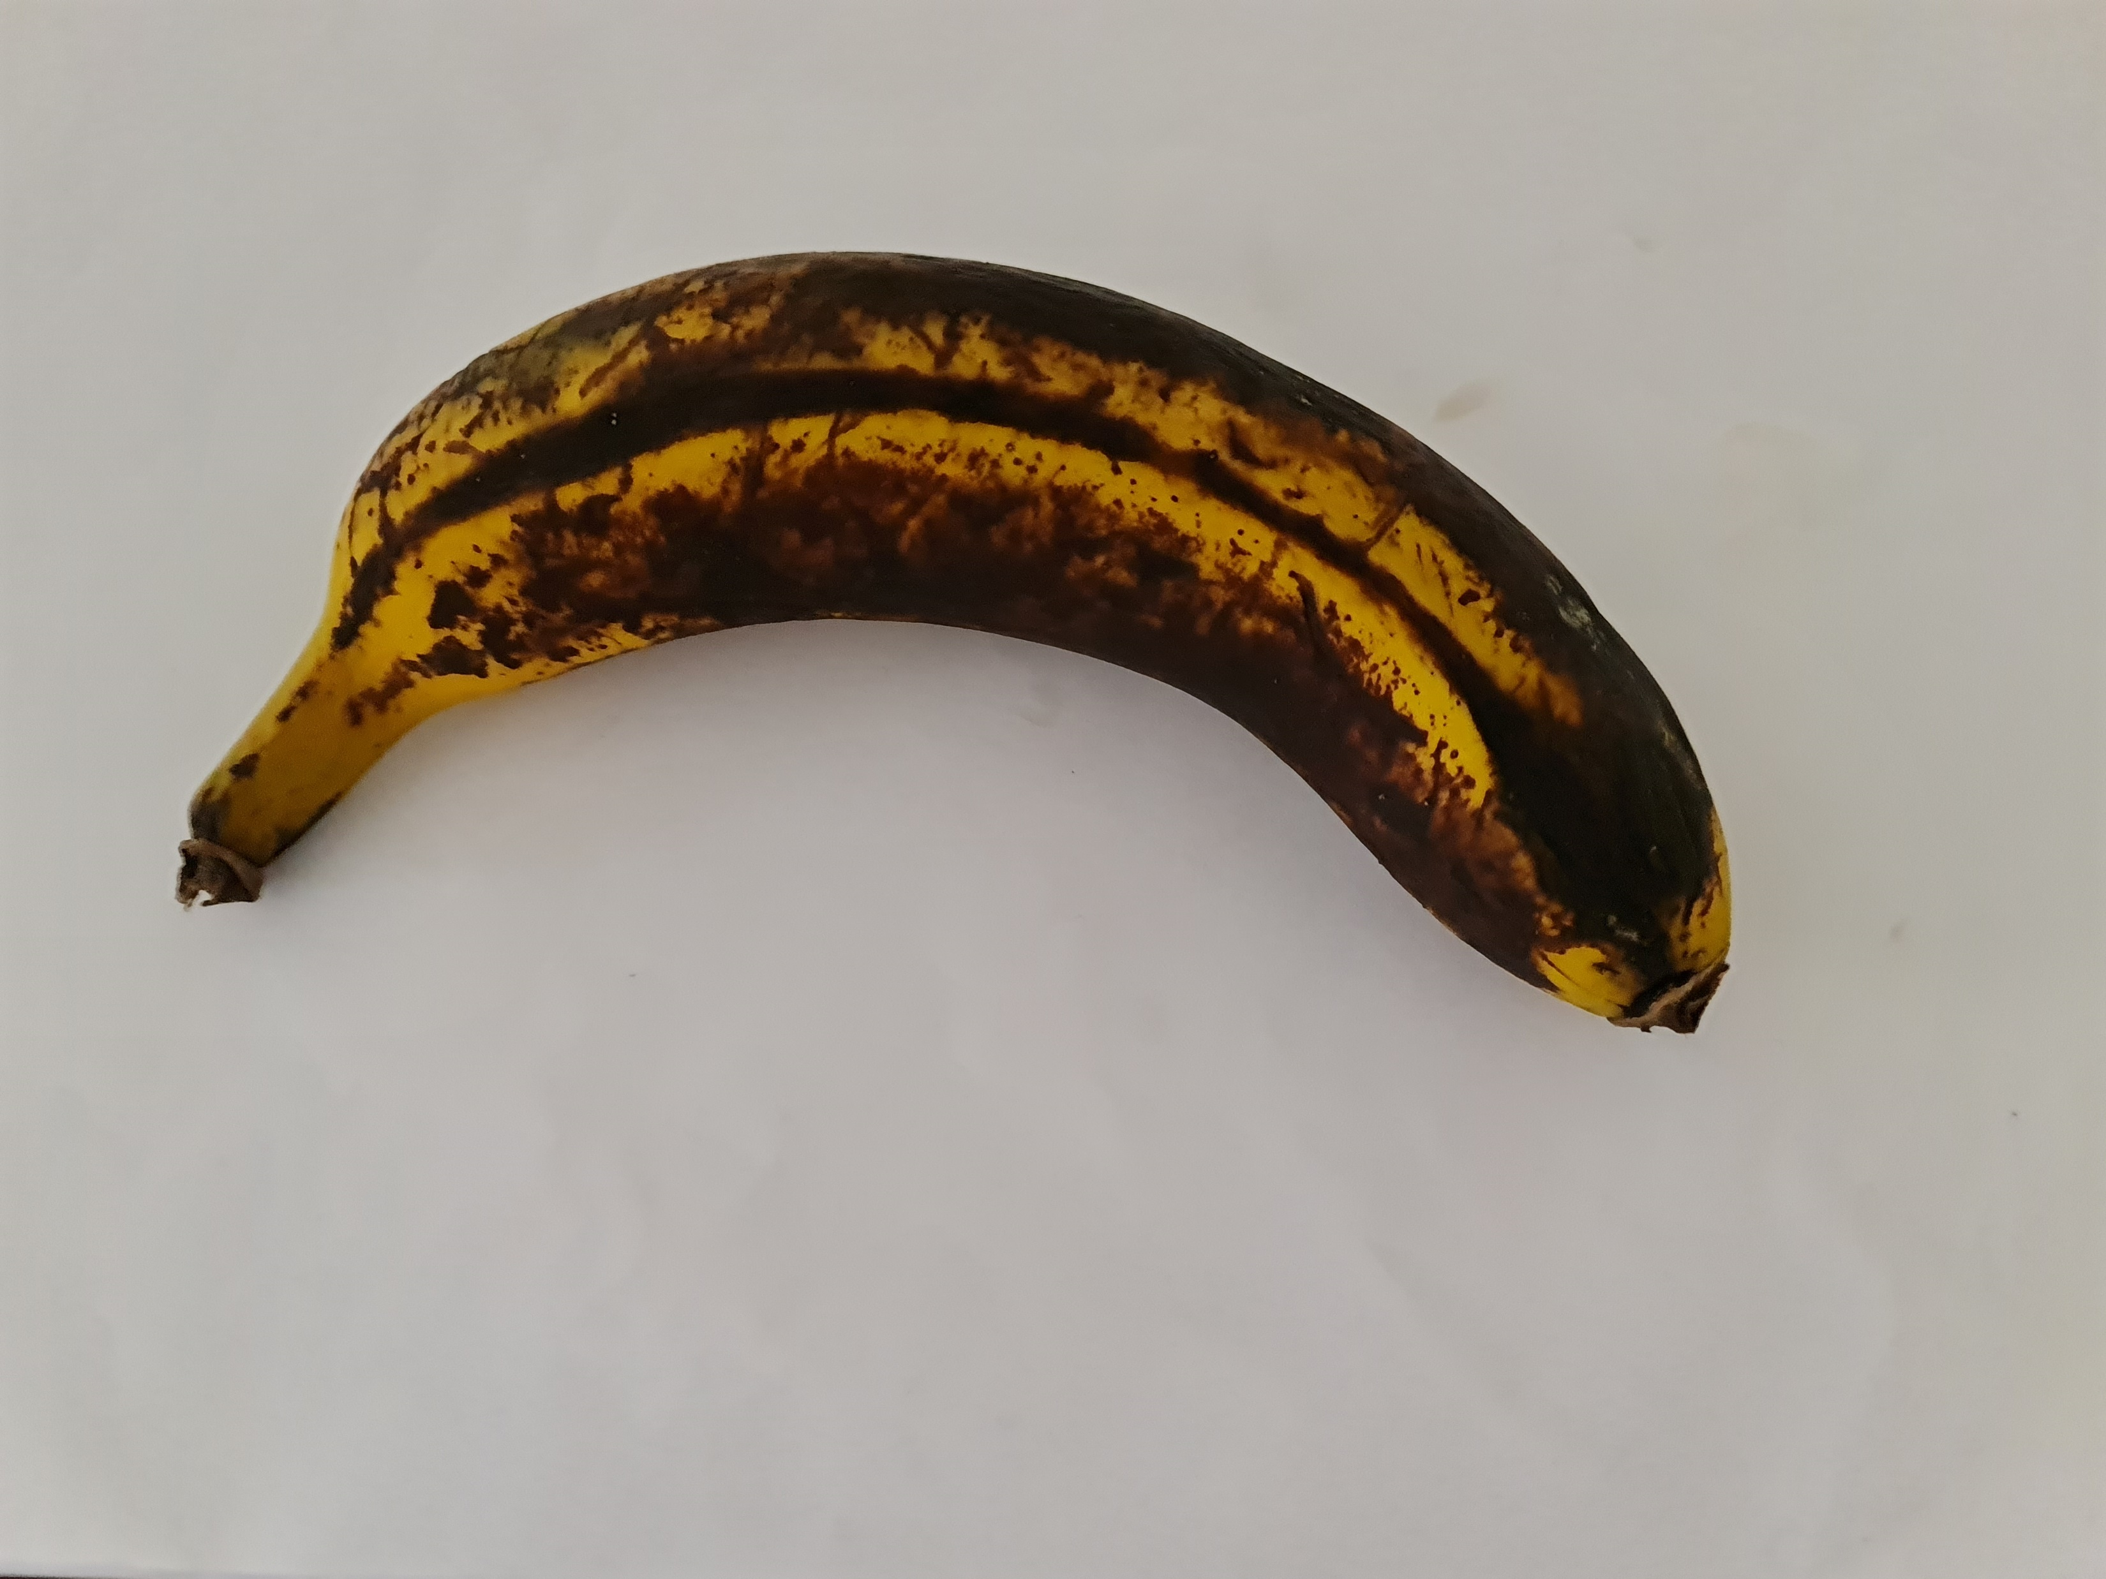
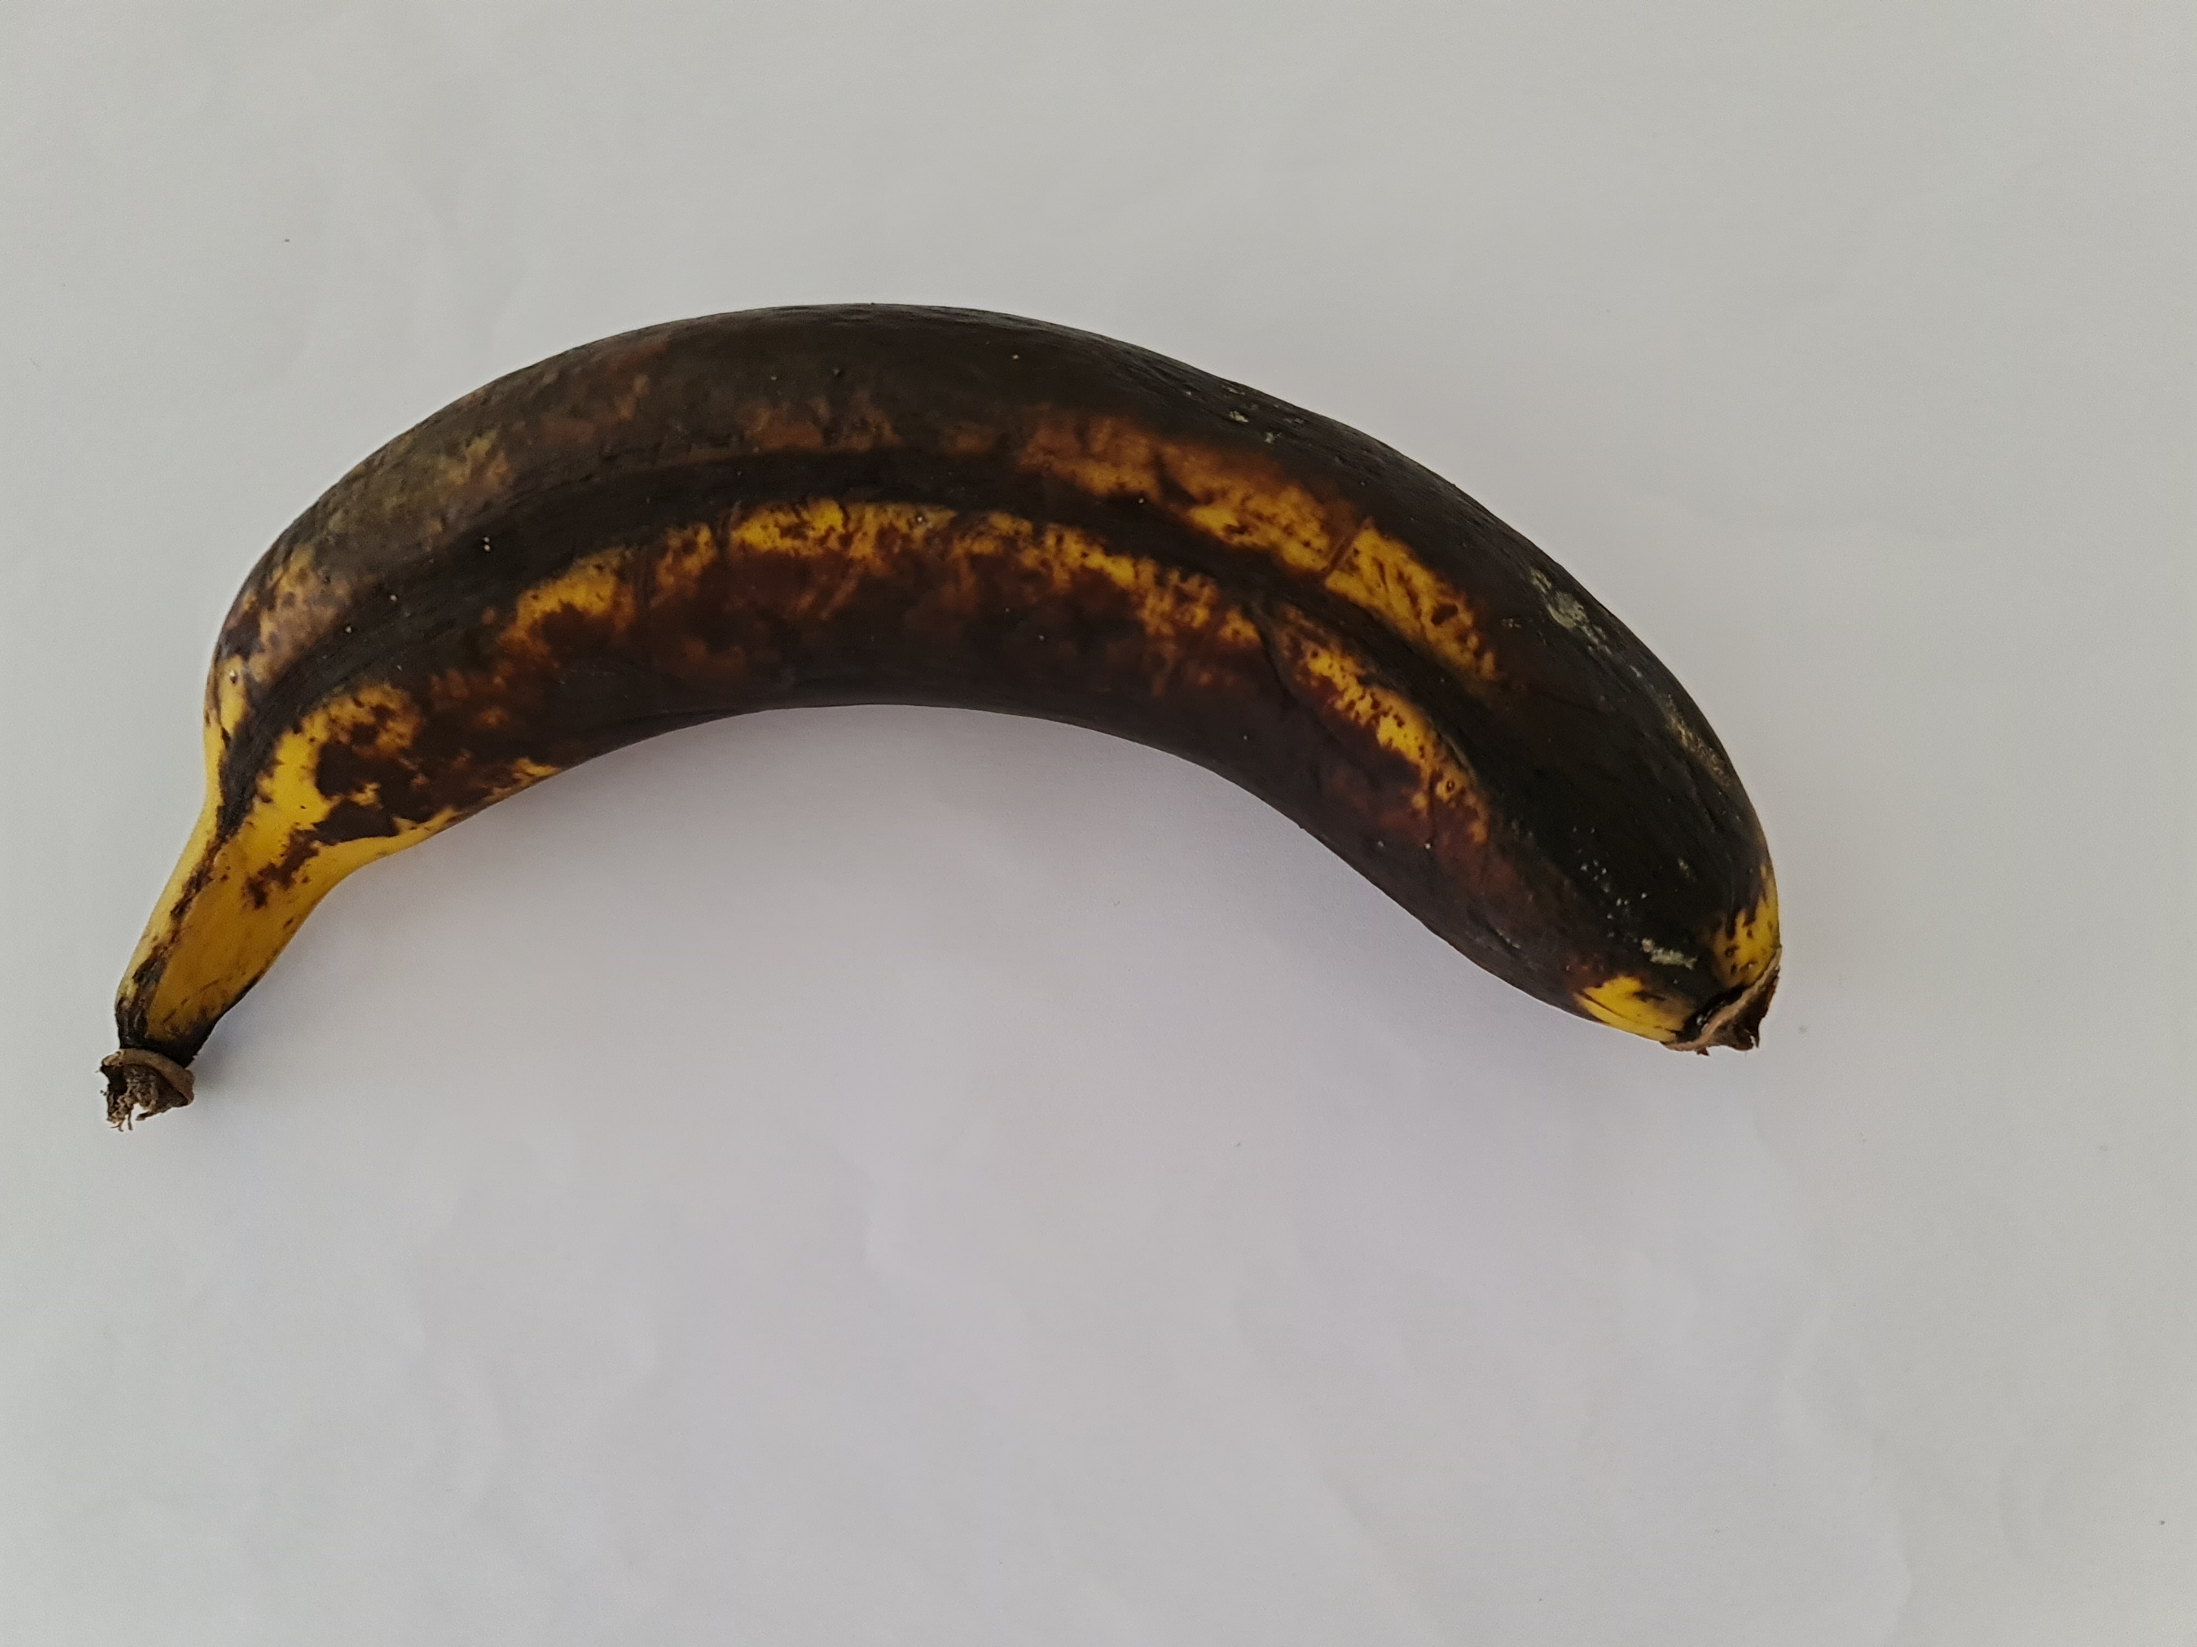
Second step – build the dataset
Day 1
Day 2
Day 3
Day 4
Day 5
Day 6
Day 7
Day 8
Day 9
Day 10
Day 11

Slide 15
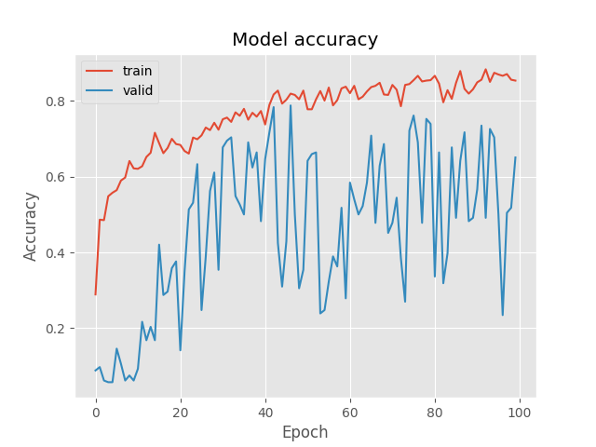
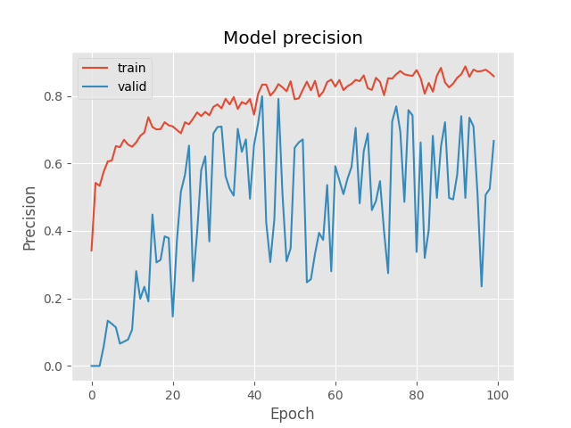
Training Banana Results
Our model reached training Precision of 85.83% and 66.67% for validation.
Our model reached training accuracy of 85.32% and 65.04% for validation.

Slide 16
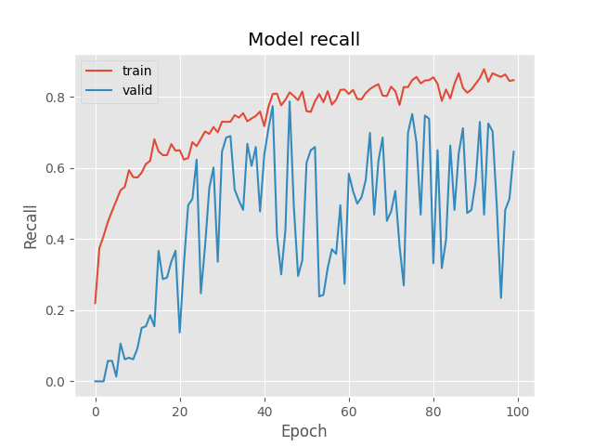
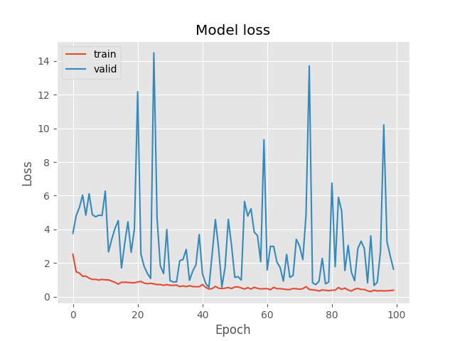
Training Banana Results
Our model reached a training loss of 0.3818 and 1.6352 for validation.
Our model reached a training recall of 84.75% and 64.60% for validation.

Slide 17
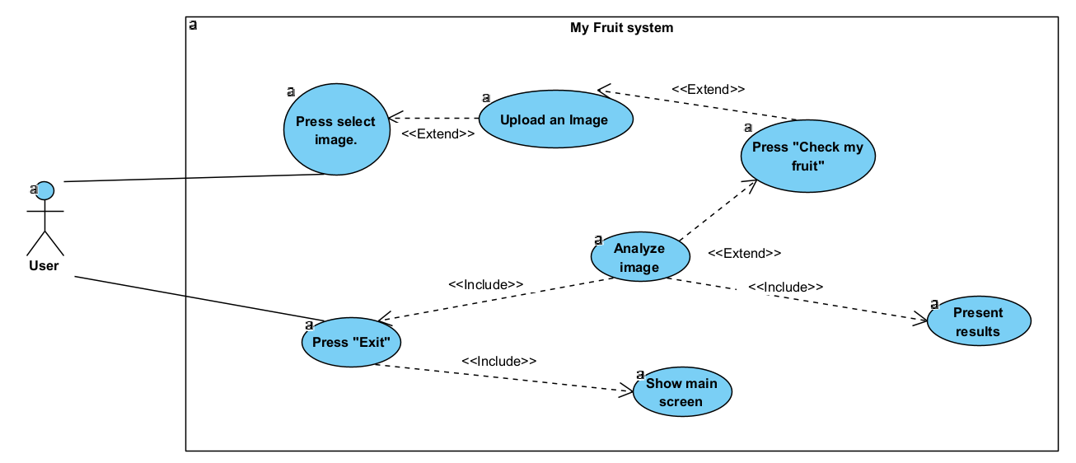
UseCase - Ripeness Fruits System

Slide 18
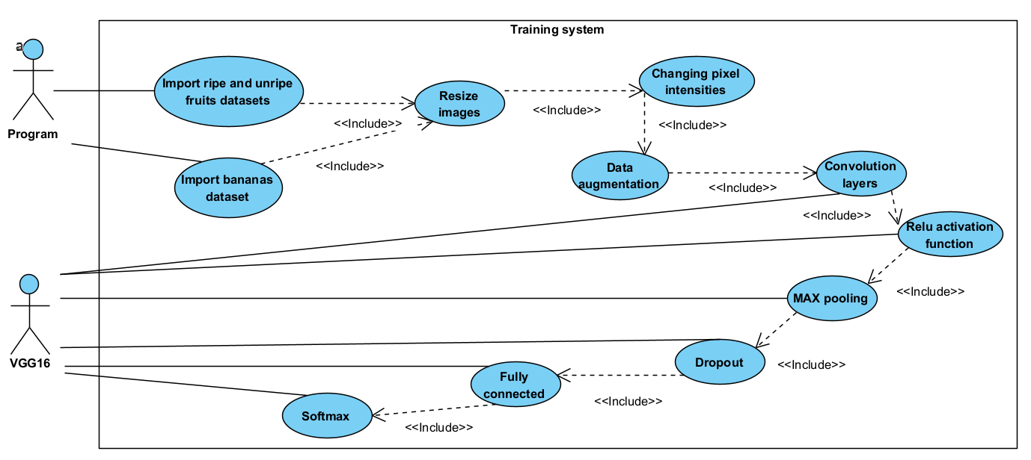
UseCase - Training system

Slide 19
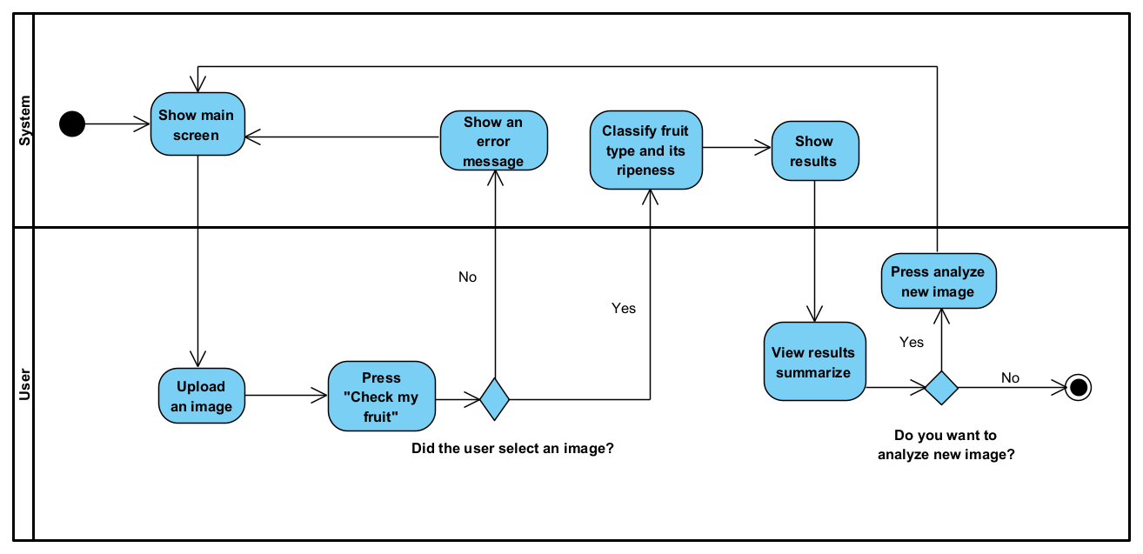
Activity - Ripeness Fruits System

Slide 20
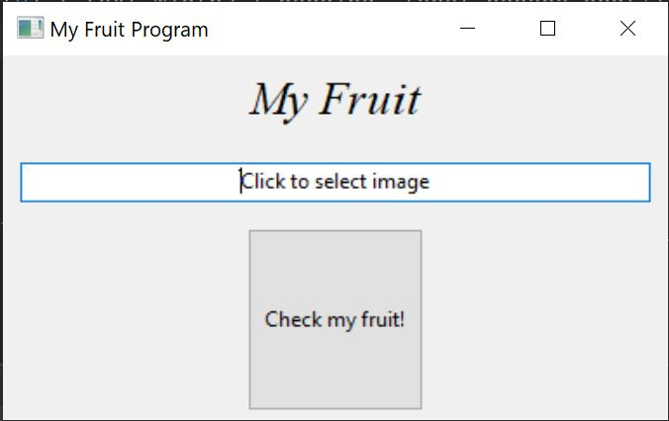
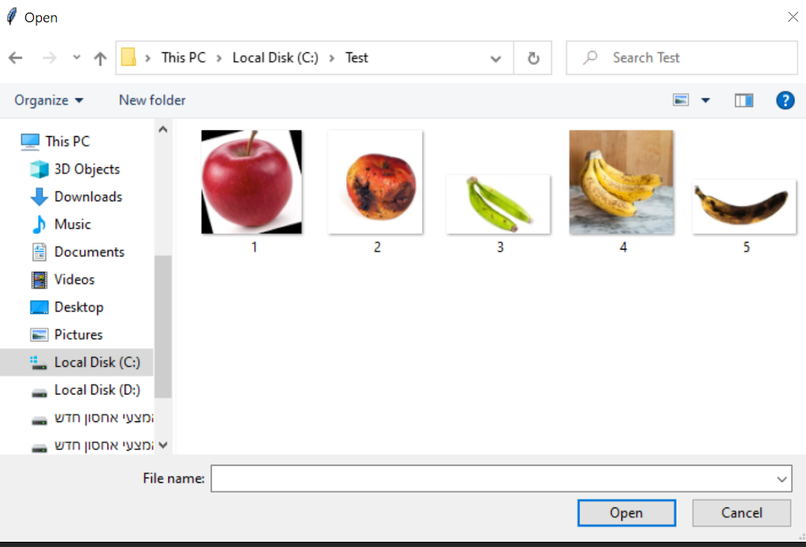
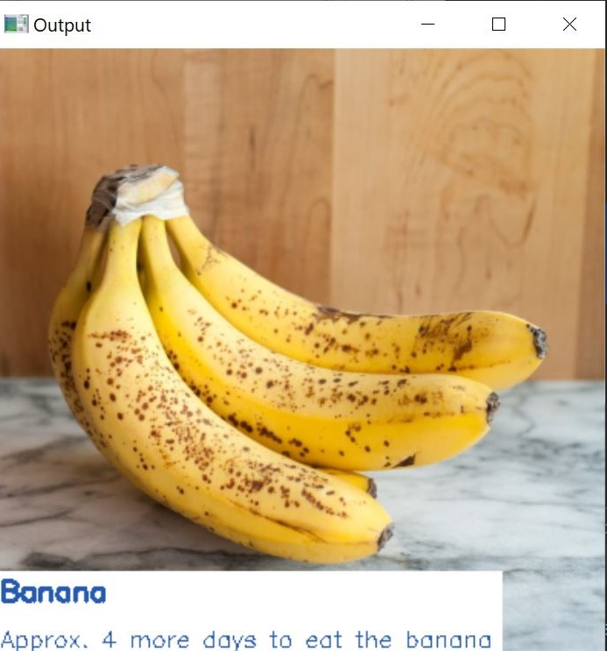
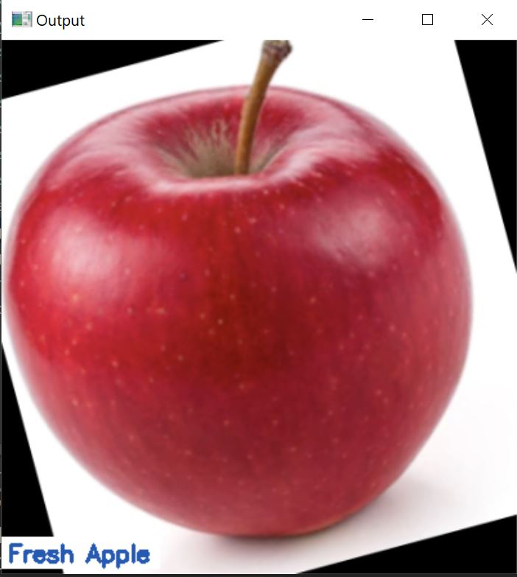
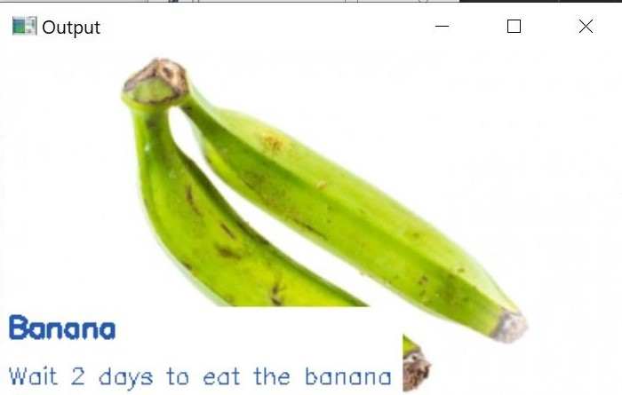
Screens

Slide 21
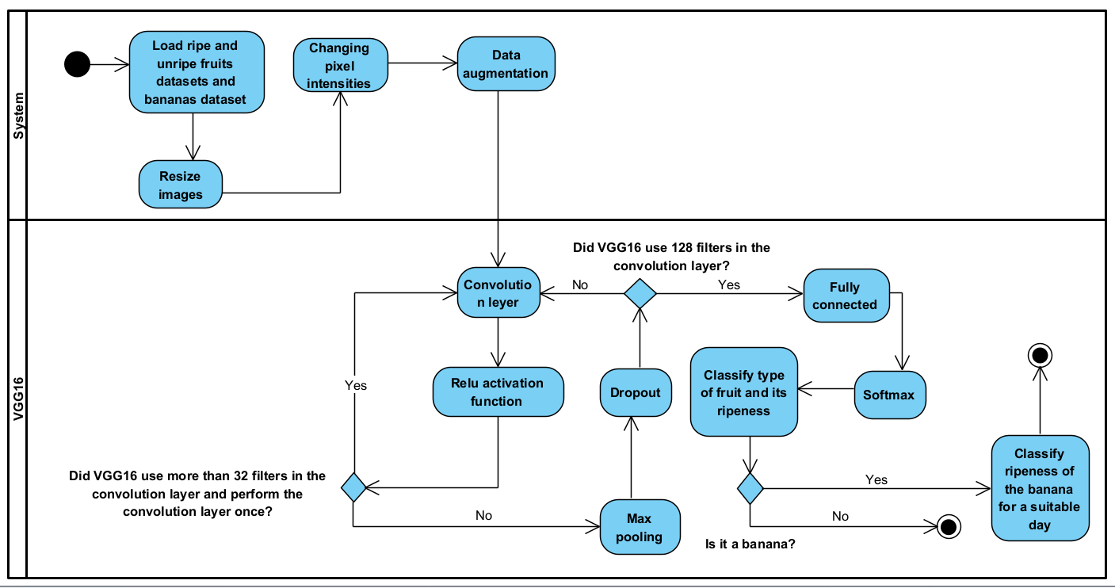
Activity - Training ripe and unripe fruits model

Slide 22

Demo

Slide 23
Conclusion
We present a fruit type classification model
And a ripeness level classification model
We learned a lot about the classification process
And we overcame difficulties we encountered
We introduced the functionality of the system

Slide 24
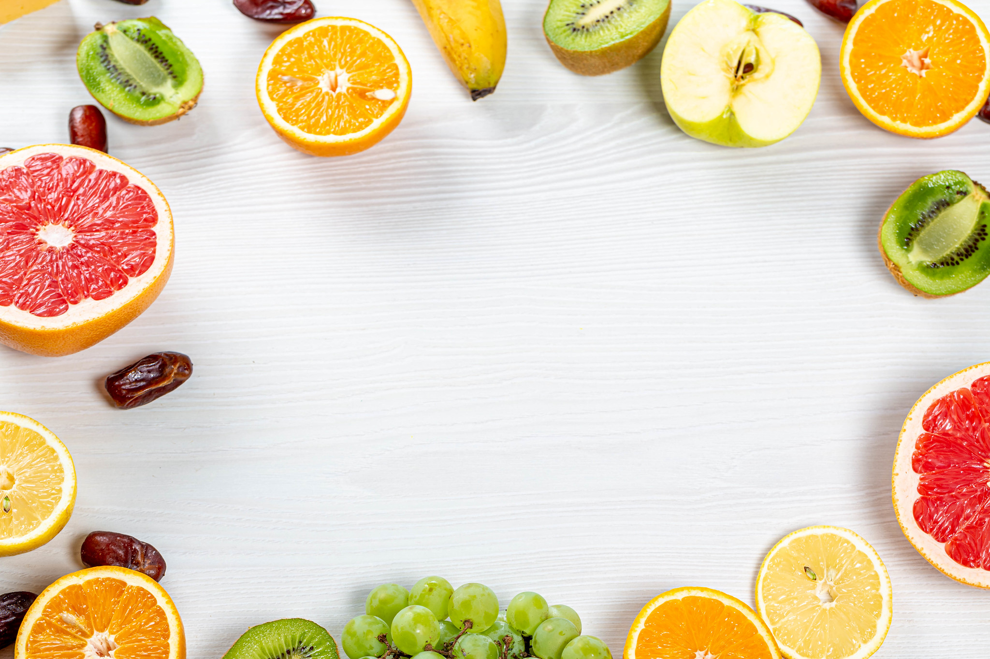
Thank you

